Slide 1
Northwind Sales Analysis
Prepared by
Divya shree

Slide 2
Contents
Dataset Overview
Tools used
Steps followed
Problems

Slide 3
Northwind Sales Analysis Project
This project focuses on creating an interactive dashboard to analyze sales performance and customer trends using the Northwind database.
By leveraging SQL, this project provides actionable insights to support strategic decision-making and marketing strategies.

Slide 4
Tools used
SQL Server Management Studio

Slide 5
Steps followed
Import Northwind dataset into SQL Server
Used SQL functions to query datasets and answer the questions

Slide 6
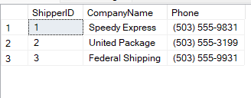
Which shippers do we have?
SELECT *
FROM [dbo].[Shippers]

Slide 7
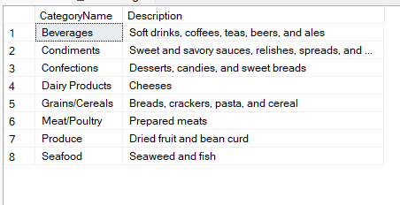
Certain fields from Categories
SELECT CategoryName, Description
from [dbo].[Categories]

Slide 8
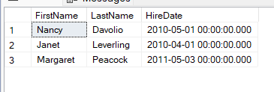
Sales Representatives in the United States
Select FirstName, LastName, HireDate
from [dbo].[Employees]
where Title = 'Sales Representative' and Country = 'USA';

Slide 9
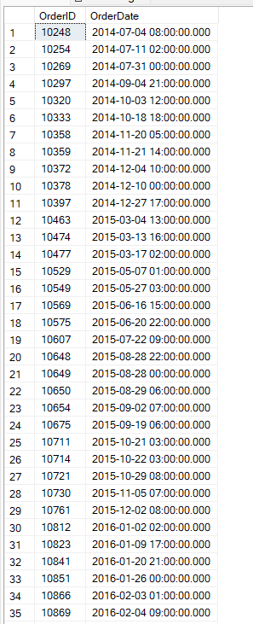
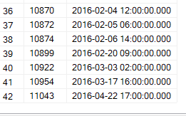
Orders placed by specific EmployeeID
SELECT OrderID, OrderDate from [dbo].[Orders] where EmployeeID=5;

Slide 10

Products with “queso” in ProductName
Select ProductId, ProductName from [dbo].[Products] where ProductName like '%queso%';

Slide 11
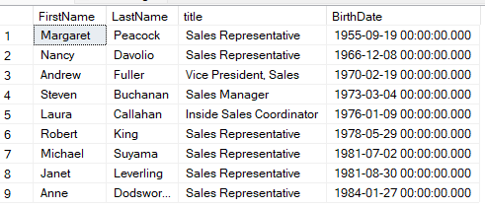
Employees, in order of age
Select FirstName, LastName, title, BirthDate from [dbo].[Employees] order by BirthDate asc;

Slide 12
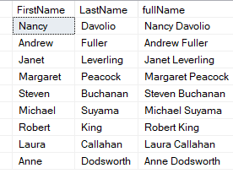
Employees full name
Select FirstName, LastName, FirstName + ' ' + LastName as fullName from [dbo].[Employees]

Slide 13

When was the first order?
Select top 1 OrderDate as first_order
from [dbo].[Orders]
order by OrderDate asc;

Slide 14
Products that need reordering, continued
Select [ProductID], [ProductName], [SupplierID], [CategoryID], [QuantityPerUnit], [UnitPrice], [UnitsInStock], [UnitsOnOrder], [ReorderLevel], [Discontinued]
from [dbo].[Products]
where ((UnitsInStock + UnitsOnOrder) <=ReorderLevel) and Discontinued = 0 order by ProductID;

Slide 15
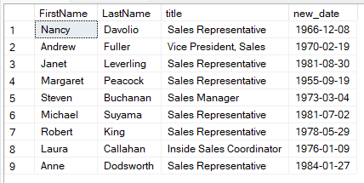
Showing only the Date with a DateTime field
Select FirstName, LastName, title, cast(BirthDate as date) as new_date
from [dbo].[Employees]

Slide 16
THANK YOU

